Slide 1
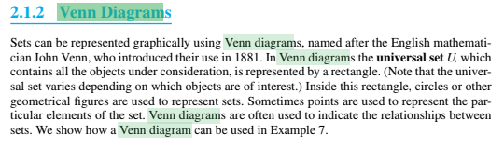
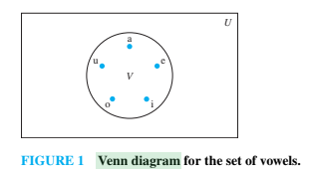
Venn Diagram

Slide 2
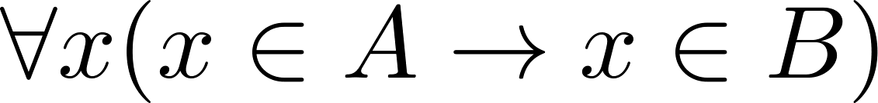
Subsets
Definition: The set A is a subset of B, if and only if every element of A is also an element of B.
The notation A ⊆ B is used to indicate that A is a subset of the set B.
A ⊆ B holds if and only if is true.
Because a ∈ ∅ is always false, ∅ ⊆ S ,for every set S.
Because a ∈ S → a ∈ S, S ⊆ S, for every set S.

Slide 3
Showing a Set is or is not a Subset of Another Set
Showing that A is a Subset of B: To show that A ⊆ B, show that if x belongs to A, then x also belongs to B.
Showing that A is not a Subset of B: To show that A is not a subset of B, A ⊈ B, find an element x ∈ A with x ∉ B. (Such an x is a counterexample to the claim that x ∈ A implies x ∈ B.)
Examples:
The set of all computer science majors at your school is a subset of all students at your school.
The set of integers with squares less than 100 is not a subset of the set of nonnegative integers, because negative numbers have square also less than hundred.

Slide 4
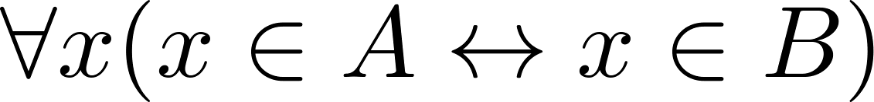
Another look at Equality of Sets
Recall that two sets A and B are equal, denoted by A = B, iff
Using logical equivalences we have that A = B iff
This is equivalent to
A ⊆ B and B ⊆ A

Slide 5
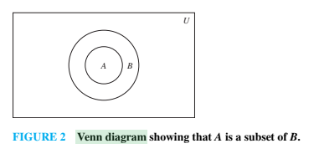
Proper Subsets
Definition: If A ⊆ B, but A ≠B, then we say A is a proper subset of B, denoted by A ⊂ B. If A ⊂ B, then
is true.
Venn Diagram

Slide 6
Set Cardinality
Definition: If there are exactly n distinct elements in S where n is a nonnegative integer, we say that S is finite. Otherwise it is infinite.
Definition: The cardinality of a finite set A, denoted by |A|, is the number of (distinct) elements of A.
Examples:
|ø| = 0
Let S be the letters of the English alphabet. Then |S| = 26
|{1,2,3}| = 3
|{ø}| = 1
The set of integers is infinite.

Slide 7
Power Sets
Definition: The set of all subsets of a set A, denoted P(A), is called the power set of A.
Example: If A = {a,b} then
P(A) = {ø, {a},{b},{a,b}}
If a set has n elements, then the cardinality of the power set is 2ⁿ. (In Chapters 5 and 6, we will discuss different ways to show this.)

Slide 8
Tuples
The ordered n-tuple (a₁,a₂,…..,a_{n}) is the ordered collection that has a₁ as its first element and a₂ as its second element and so on until a_{n} as its last element.
Two n-tuples are equal if and only if their corresponding elements are equal.
2-tuples are called ordered pairs.
The ordered pairs (a,b) and (c,d) are equal if and only if a = c and b = d.

Slide 9
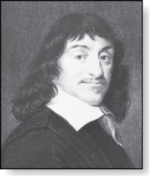
Cartesian Product
René Descartes (1596-1650)
Definition: The Cartesian Product of two sets A and B, denoted by A × B is the set of ordered pairs (a,b) where a ∈ A and b ∈ B .
Example:
A = {a,b} B = {1,2,3}
A × B = {(a,1),(a,2),(a,3), (b,1),(b,2),(b,3)}
Definition: A subset R of the Cartesian product A × B is called a relation from the set A to the set B. (Relations will be covered in depth in Chapter 9. )

Slide 10
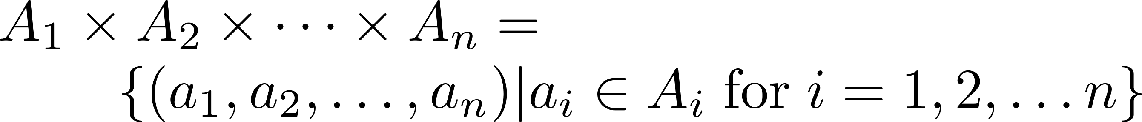
Cartesian Product
Definition: The cartesian products of the sets A₁,A₂,……,A_{n}, denoted by A₁ × A₂ × …… × A_{n} , is the set of ordered n-tuples (a₁,a₂,……,a_{n}) where a_{i} belongs to A_{i} for i = 1, … n.
Example: What is A × B × C where A = {0,1}, B = {1,2} and C = {0,1,2}
Solution: A × B × C = {(0,1,0), (0,1,1), (0,1,2),(0,2,0), (0,2,1), (0,2,2),(1,1,0), (1,1,1), (1,1,2), (1,2,0), (1,2,1), (1,1,2)}

Slide 11
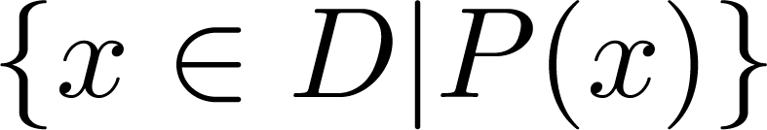
Truth Sets of Quantifiers
Given a predicate P and a domain D, we define the truth set of P to be the set of elements in D for which P(x) is true. The truth set of P(x) is denoted by
Example: The truth set of P(x) where the domain is the integers and P(x) is “|x| = 1” is the set {-1,1}. |x| is absolute value of x.

Slide 13
Set Operations
Section 2.2

Slide 14
Section Summary
Set Operations
Union
Intersection
Complementation
Difference
More on Set Cardinality
Set Identities
Proving Identities
Membership Tables

Slide 15
Boolean Algebra
Propositional calculus and set theory are both instances of an algebraic system called a Boolean Algebra. This is discussed in Chapter 12.
The operators in set theory are analogous to the corresponding operator in propositional calculus.
As always there must be a universal set U. All sets are assumed to be subsets of U.

Slide 16
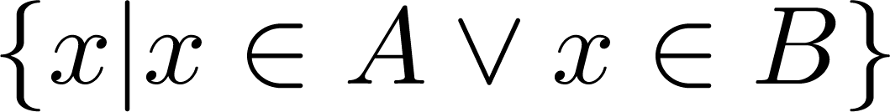
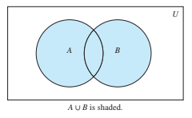
Union
Definition: Let A and B be sets. The union of the sets A and B, denoted by A ∪ B, is the set:
Example: What is {1,2,3} ∪ {3, 4, 5}?
Solution: {1,2,3,4,5}
Venn Diagram for A ∪ B

Slide 17
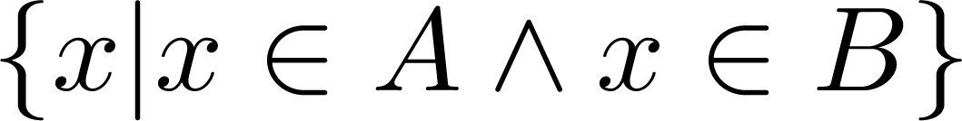
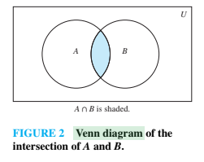
Intersection
Definition: The intersection of sets A and B, denoted by A ∩ B, is
Note if the intersection is empty, then A and B are said to be disjoint.
Example: What is? {1,2,3} ∩ {3,4,5} ?
Solution: {3}
Example:What is?
{1,2,3} ∩ {4,5,6} ?
Solution: ∅
Venn Diagram for A ∩B

Slide 18
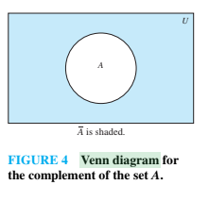
Complement
Definition: If A is a set, then the complement of the A (with respect to U), denoted by Ā is the set U - A
Ā = {x ∈ U | x ∉ A}
(The complement of A is sometimes denoted by A^{c} .)
Example: If U is the positive integers less than 100, what is the complement of {x | x > 70}
Solution: {x | x ≤ 70}
Venn Diagram for Complement
Ā

